Slide 1
Final Project I –
Proposal Presentation
By Matthew Lamoureux-Durr
H.A.L. – Home Automation Logic

Slide 2
Outline:
Motivation
Overview of project
How it works (high level)
Schematic
Timeline
Challenges so far
Conclusion

Slide 3




Slide 4
Motivation
I want to be able to control my house from my bed.
Setup routines that will automatically execute themselves.
Good user interface.
Easy to use from everywhere
Internet enabled!
Standalone

Slide 5
What my project is:
System that can control lights/appliances
Internet enabled over Ethernet
Also USB
Graphical LCD (graphing capability)
Programmable schedule
External relays
Modular design (add more stuff later!)

Slide 6
High Level Design
LCD
Ethernet
Micro
Relays
Sensors
Power supply

Slide 7
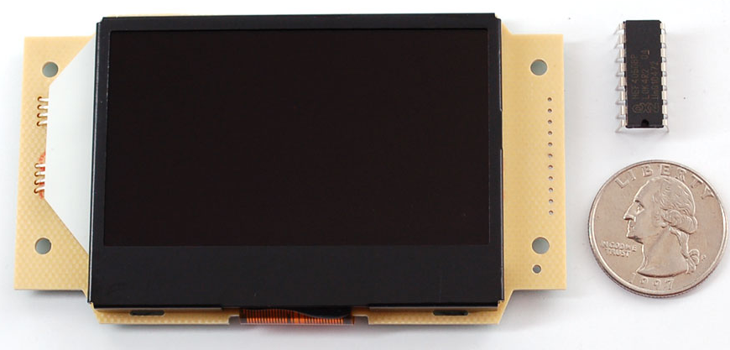
LCD From Adafruit
ST7565 Graphical LCD
128x64 (monochrome, no color)
RBG backlight
SPI interface
3.3V logic

Slide 8
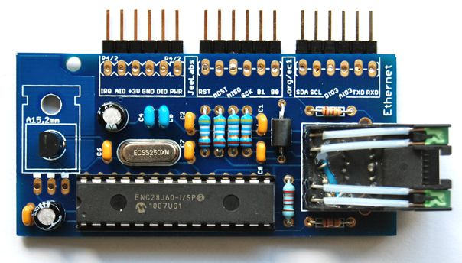
Ethernet from Microchip/ModernDevice
ENC29J60 DIP package
10Mb/s
SPI interface
3.3V logic

Slide 9
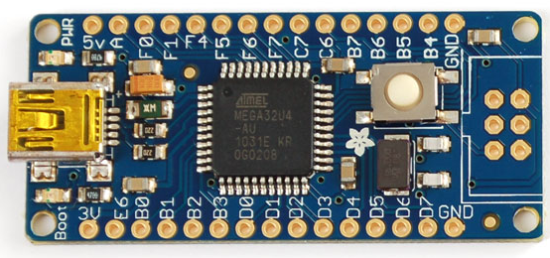
Micro from Adafruit
ATMEGA32u4
32 KB flash, 2.5 KB RAM 1 KB EEPROM
16 MIPS @ 16 MHz
2 SPI, 1 UART, 1 I2C, 1 USB!, 12 ADC,
6 PWM
MAX I/O 26
Internal Temp sensor

Slide 10
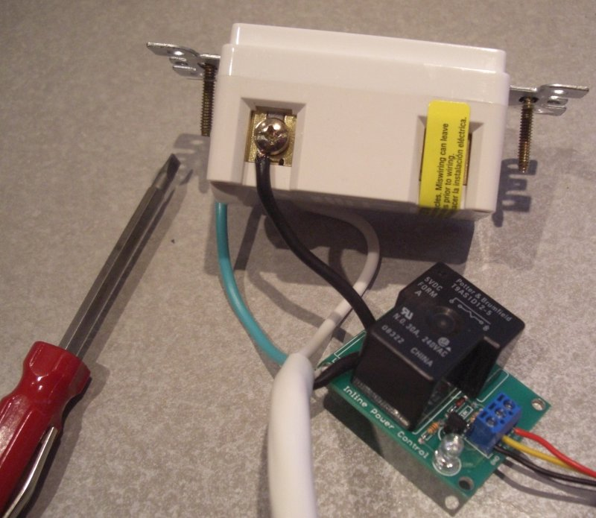
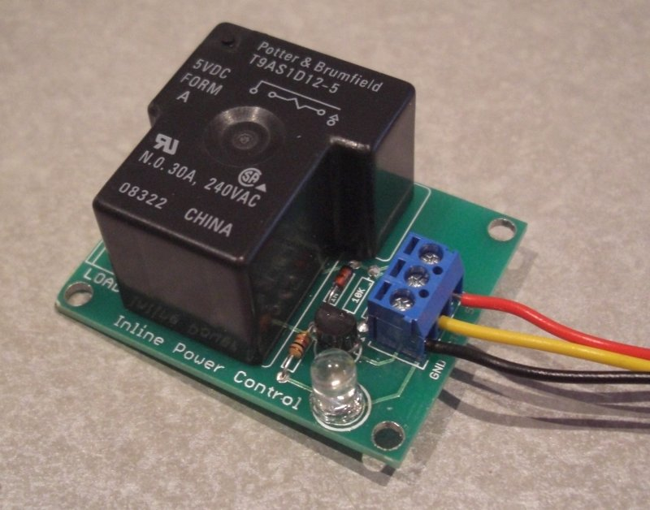
Relays
The relays will be external
Let’s you choose how big relay is.

Slide 11
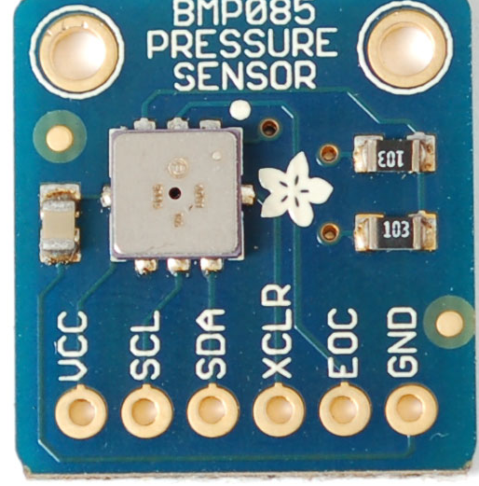
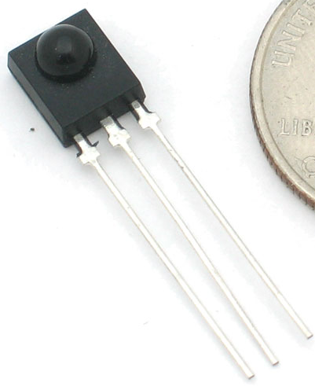
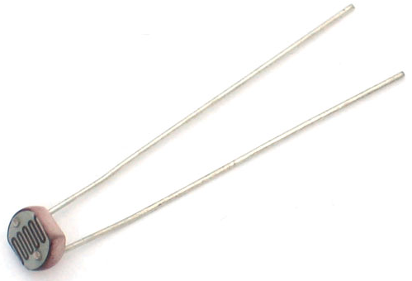
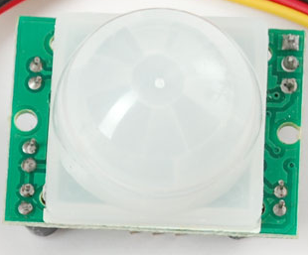
Sensors
So many possibilities
Temp, Light, Motion, IR and more!
Will have broken out I/O pins (ADC, PWM, etc)

Slide 12
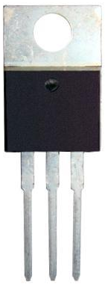
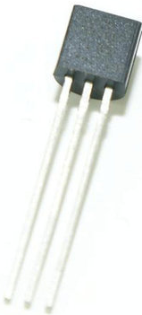
Power Supply
9V in
5V (1A) regulator for most of board.
3V (250 mA) regulator for LCD and Ethernet

Slide 13
Ethernet

Slide 14
LCD

Slide 15
MCU

Slide 16
Power Supply

Slide 17
Relay

Slide 18
Inputs

Slide 19
Timeline:
Project Gantt Chart
Milestone | Start Date | End Date
Complete Project | 8/22/2011 | 12/7/2011
Designing
Design Phase I - Brainstorm | 8/22/2011 | 9/5/2011
Design Phase II - Project Proposal | 9/5/2011 | 9/12/2011
Design Phase III - ISIS | 9/12/2011 | 9/26/2011
Design Phase IV - ARES | 10/20/2011 | 11/10/2011
Design Phase V - Project Report | 9/26/2011 | 10/19/2011
Implementation
Implementation Phase I - Order Parts | 9/26/2011 | 10/20/2011
Implementation Phase II - Bread-boarding | 9/26/2011 | 11/15/2011
Implementation Phase III - PCB Assembly | 11/15/2011 | 12/1/2011
Testing
Testing Phase I - Power Supply | 10/1/2011 | 10/7/2011
Testing Phase II - MCU | 9/15/2011 | 9/25/2011
Testing Phase III - LCD | 10/1/2011 | 10/25/2011
Testing Phase III - Ethernet | 10/15/2011 | 10/31/2011
Testing Phase III - Relays | 11/1/2011 | 11/7/2011
Testing Phase III - PCB | 11/15/2011 | 12/1/2011

Slide 20
Challenges
Keeping it all on a breadboard
Putting time in
Keeping track of parts
Picking components

Slide 21
Conclusion
Awesome
Can’t wait to get it working
Need to put more time in.
Got to get used to thinking ahead if I want to add features later.

Slide 22
References
Adafruit.com
Atmel.com
Microchip.com
Sparkfun.com
Istockphoto.com
Moderndevice.com

